Slide 1
Mass Measurements on the r-Process Path
Daniel Lascar
ANL Physics Division/Northwestern University
Student Lunch Talk
June 20, 2012

Slide 2
Mass Measurements for the Formation of the Elements
Daniel Lascar
ANL Physics Division/Northwestern University
Heavy Ion Discussion
June 20, 2012

Slide 3
The Physics Division Presents PIZZA (and a physics Talk)
Daniel Lascar
ANL Physics Division/Northwestern University
Heavy Ion Discussion
June 20, 2012

Slide 4
But Really…
Daniel Lascar
ANL Physics Division/Northwestern University
Heavy Ion Discussion
June 20, 2012

Slide 5
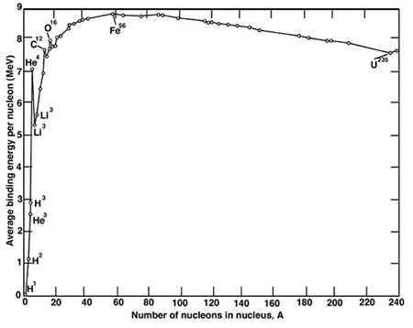
Nucleosynthesis of the Heavy Elements.
Energy Released
Energy Absorbed
Krane

Slide 6
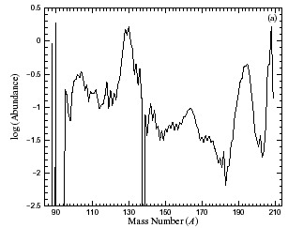
We Know Some Things From Elemental Abundances
A | N
195 | 126
130 | 82
Y.-Z. Qian, Prog. Part. Nucl. Phys., 50 (2003) 153
Notes:
These are solar system nuclidic abundances.
These peaks represent a clear demonstration that there is a tight correlation between solar system abundances and neutron shell closures.

Slide 7
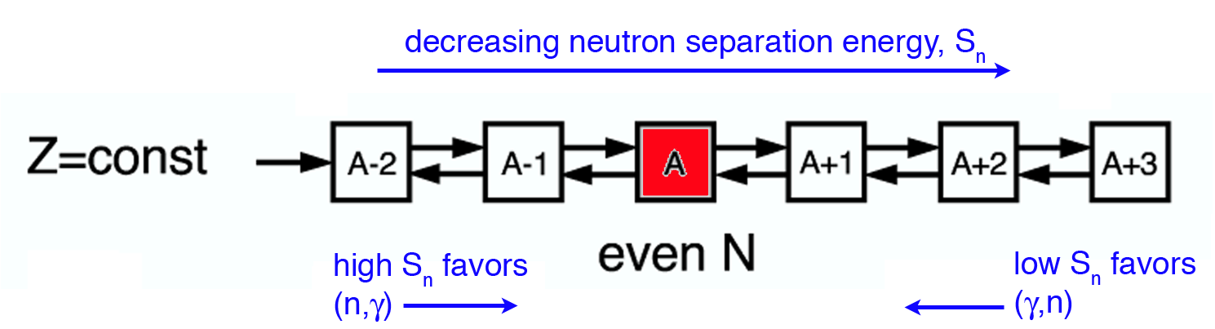
The Astrophysical R-Process
Temperatures are very high (T~10⁹K)
Neutron densities are very high (n_{n}>10²⁴ cm⁻³)
(n,γ) rate increases rapidly (~0.2 μs/capture)
As region of low neutron separation energy (S_{n}) reached (n,γ) <-> (γ,n) equilibrium achieved
Equilibrium point defined by Saha Equation
For the conditions above
…
Z
[A. Champagne, RIA Summer School ‘06]
N
5/4/2012
Notes:
Explain that it is likely a CC-SN.
This process isn’t a single line. Many assumptions go into each model, even T and n_n have a range of possibilities

Slide 8
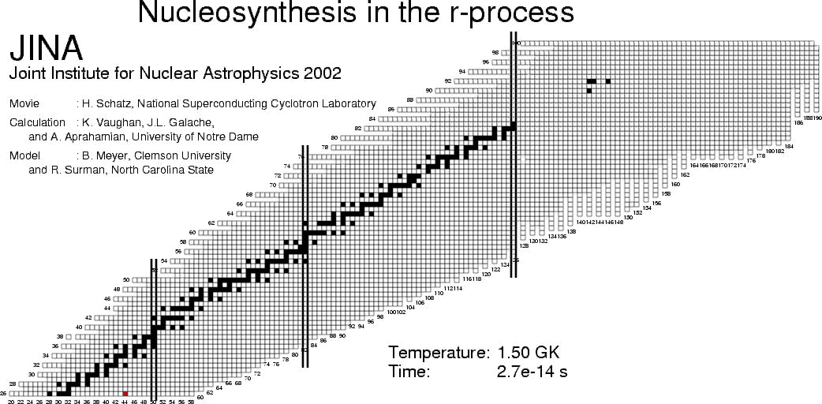
Relative Abundance
red | >= 1e-4
yellow | ~ 1e-5
green | ~ 1e-6
blue | ~ 1e-7
Notes:
The masses input into the model used to make this movie were entirely generated by the FRDM
Initial density of 290g/cm³, Initial T = 1.5 GK, Neutron to seed ratio of 92.
That means a neutron density of 10²⁶
S_n is ~5MeV
That means the r-process path in this simulation is closer to stability than the path dictated by the previous slide.

Slide 9
So What Can We Do?
CRITICAL
Known or unknown
KNOWN
LET’S FIND OUT

Slide 10
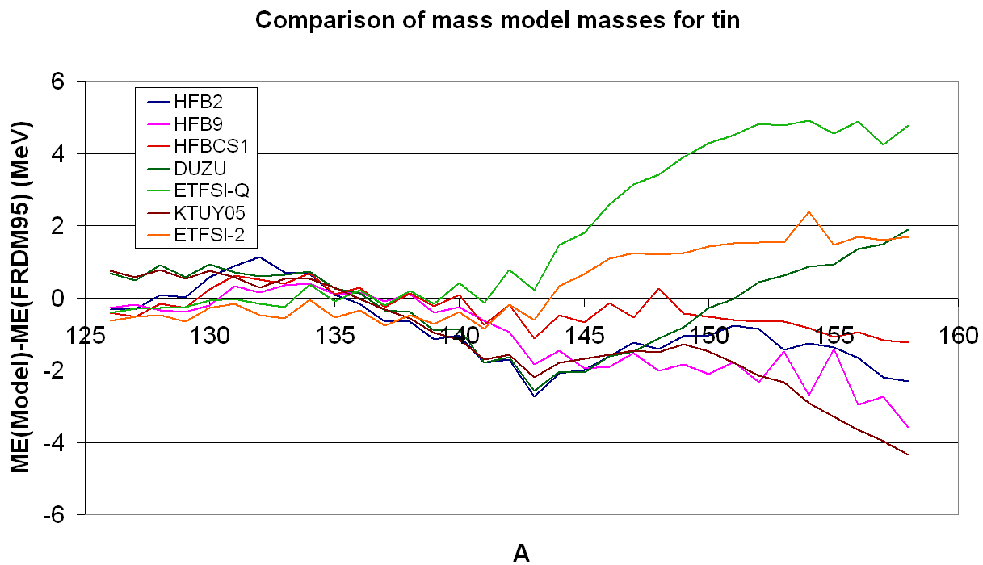
The trouble with mass models
Limit of AME03

Slide 11
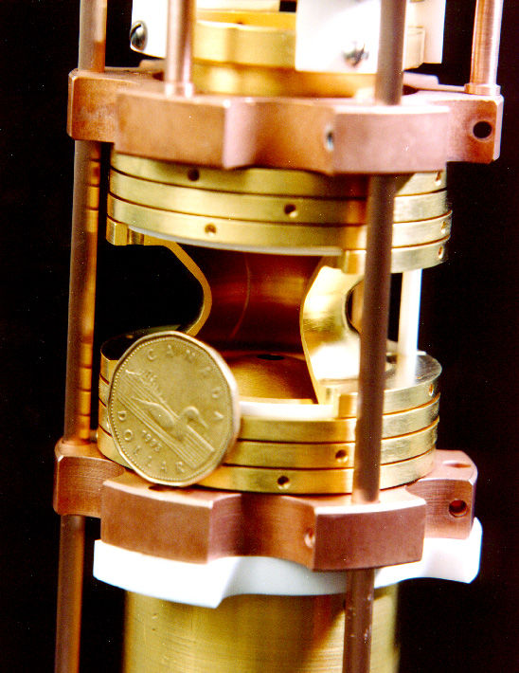
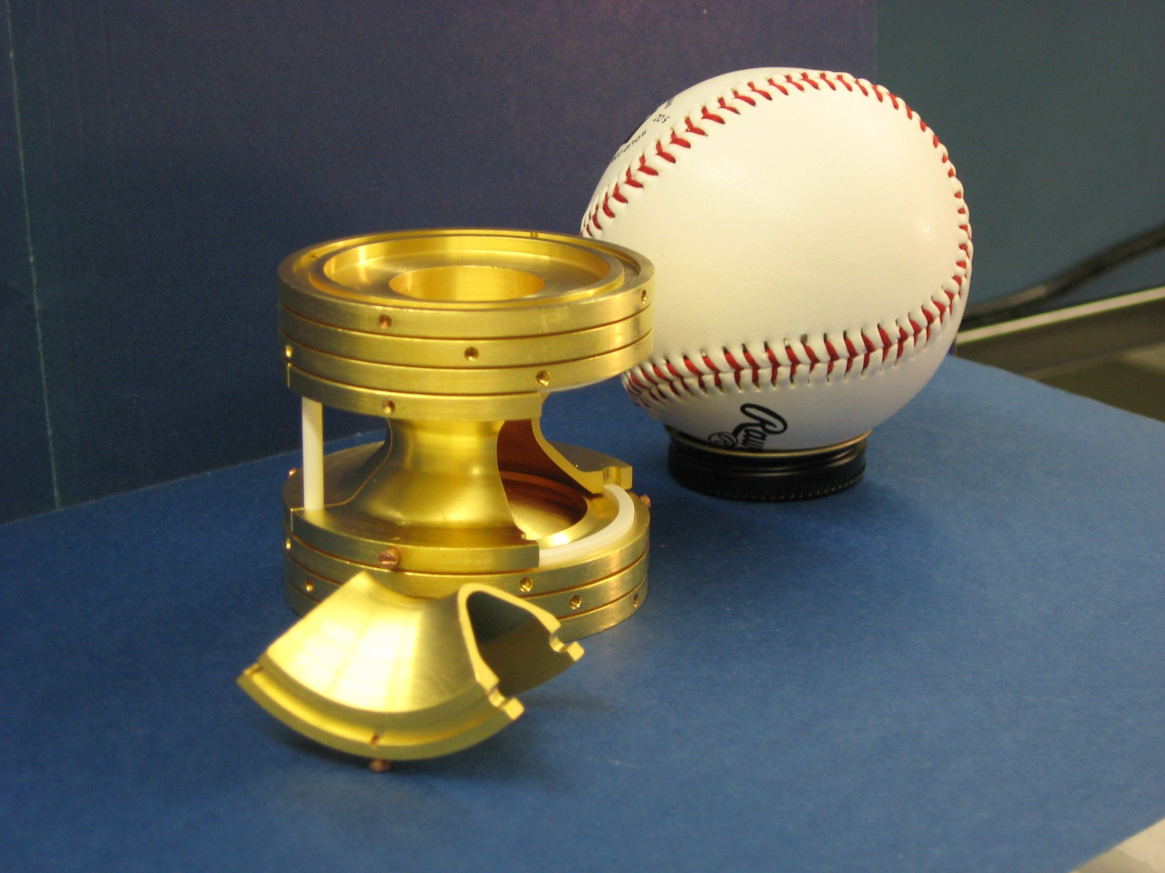
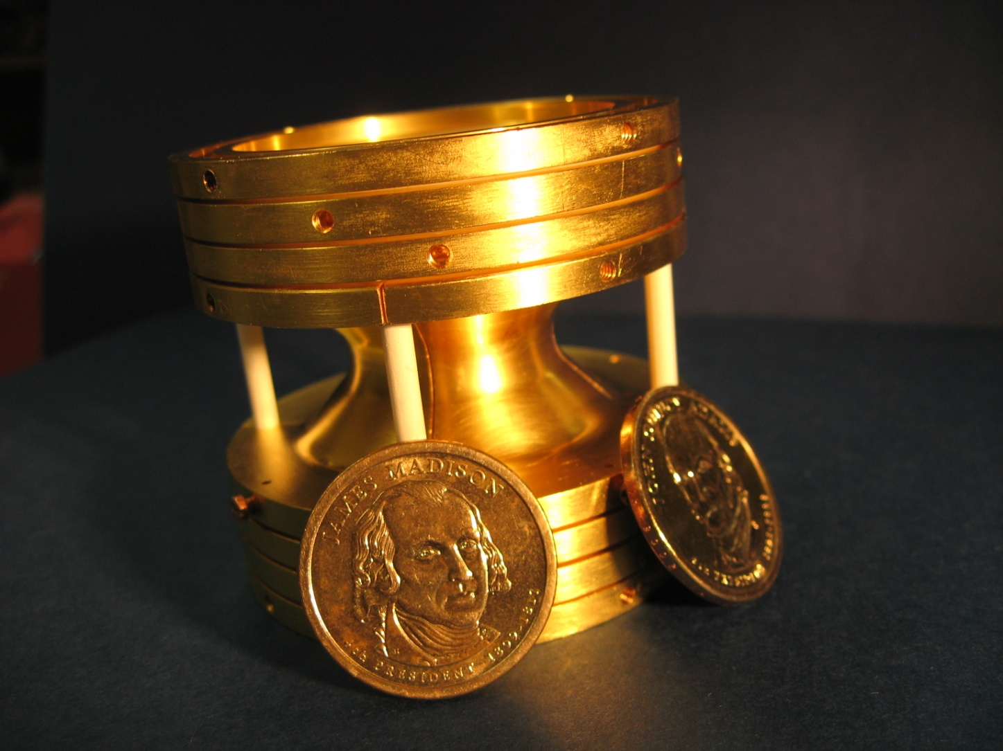
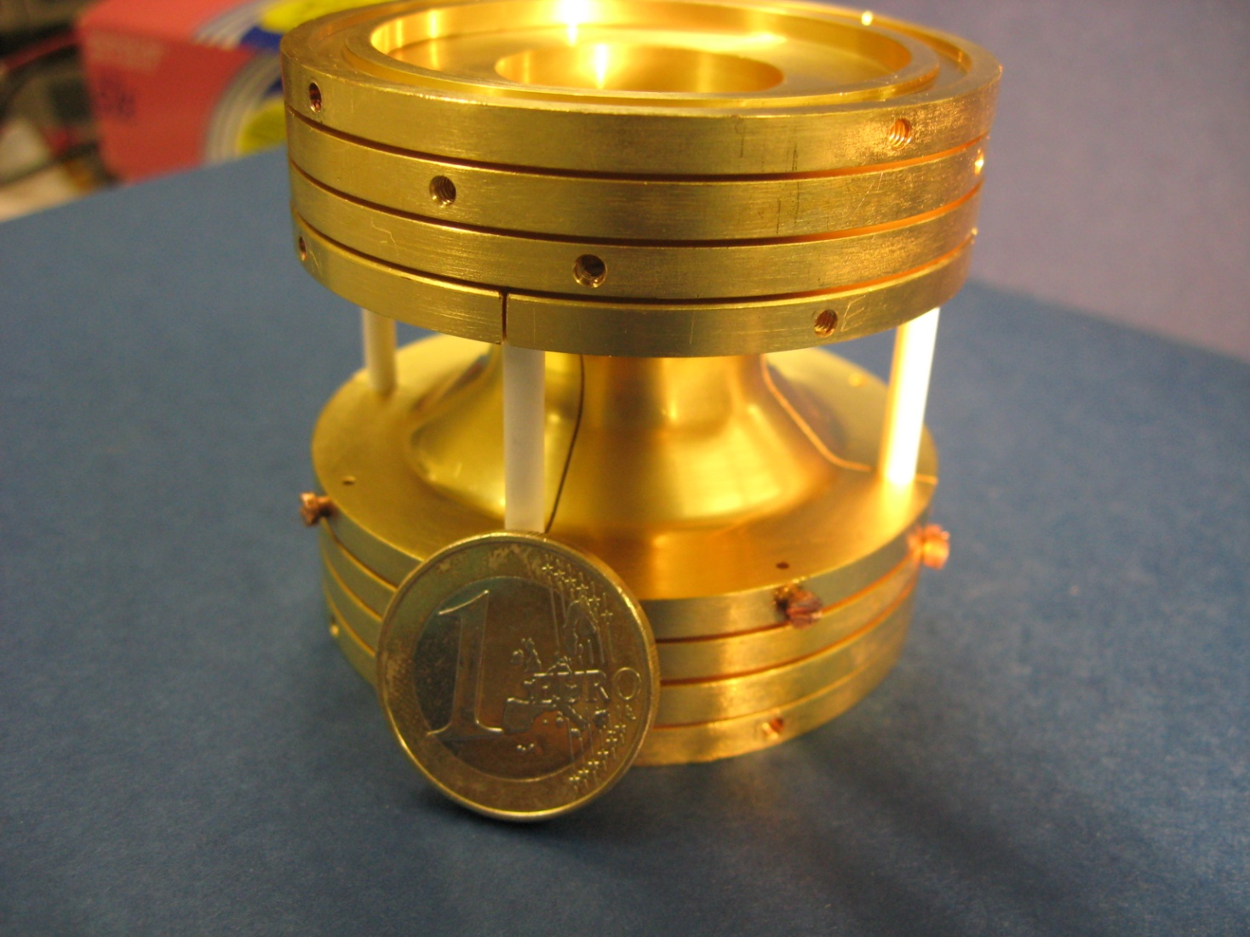
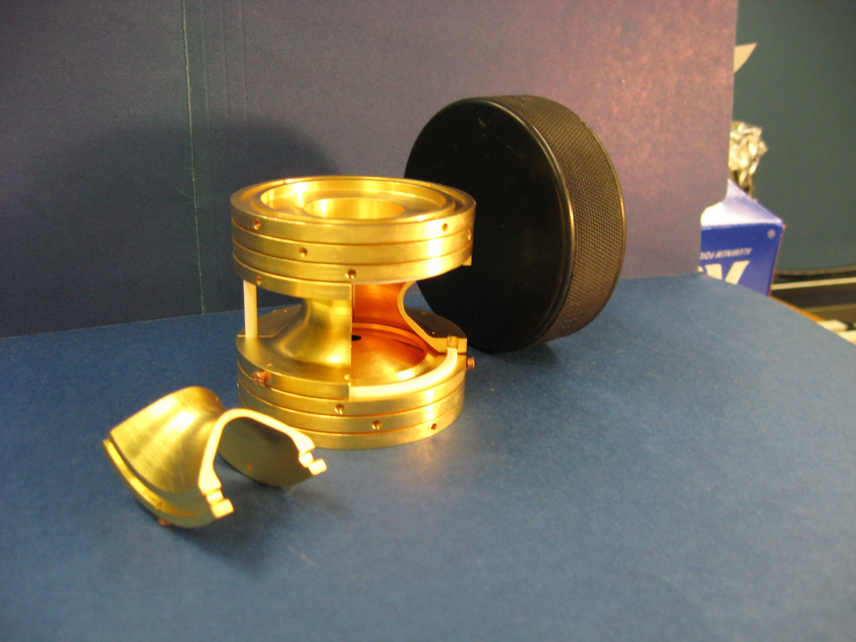
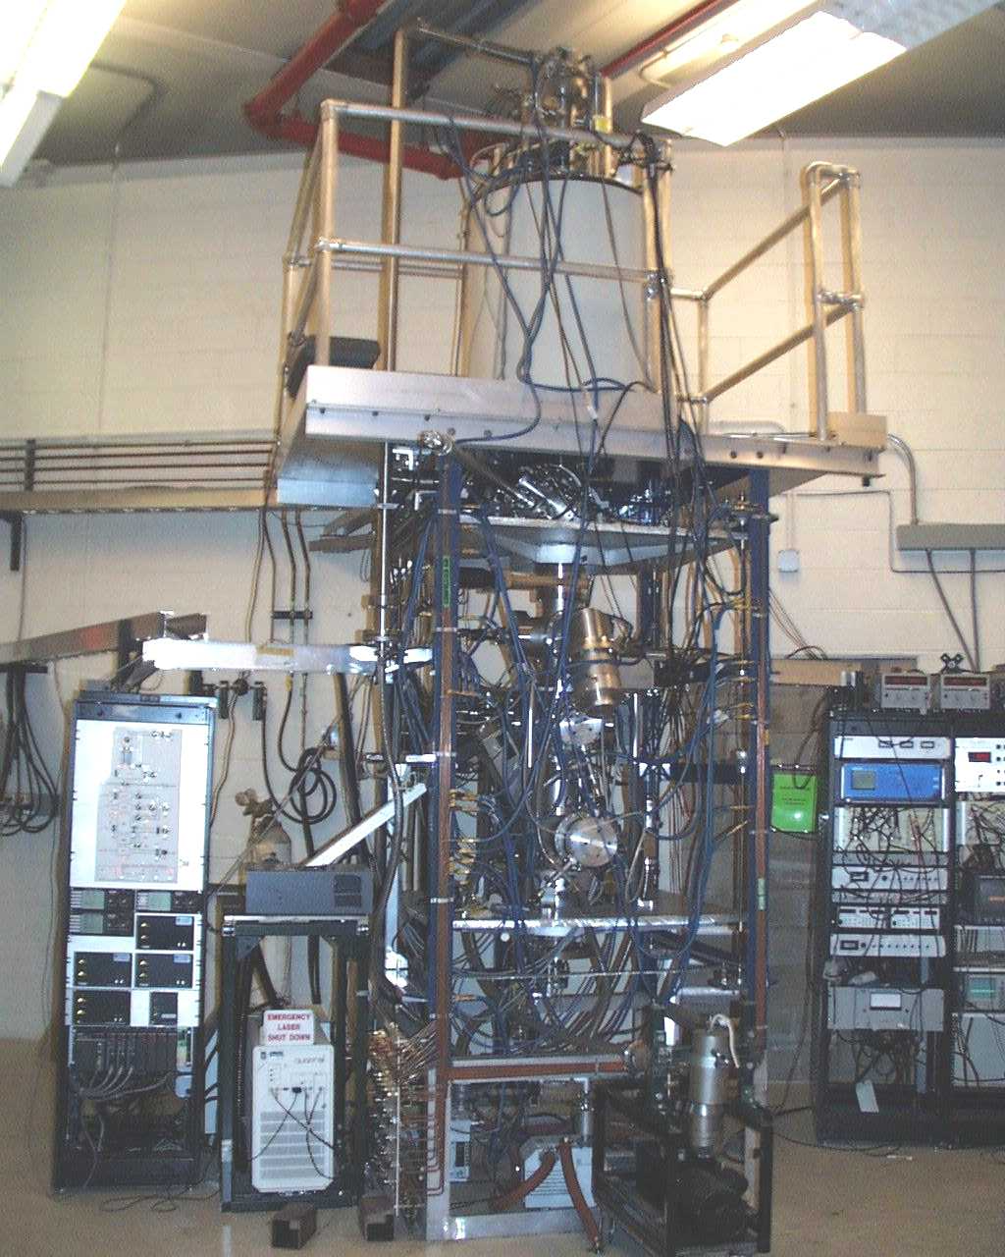
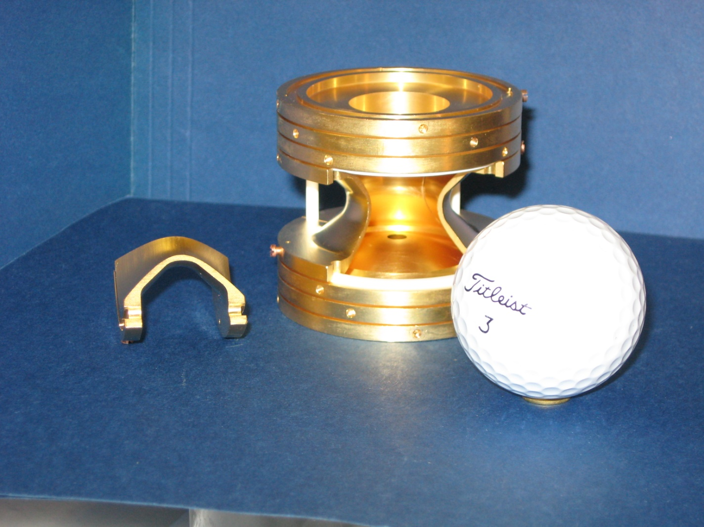
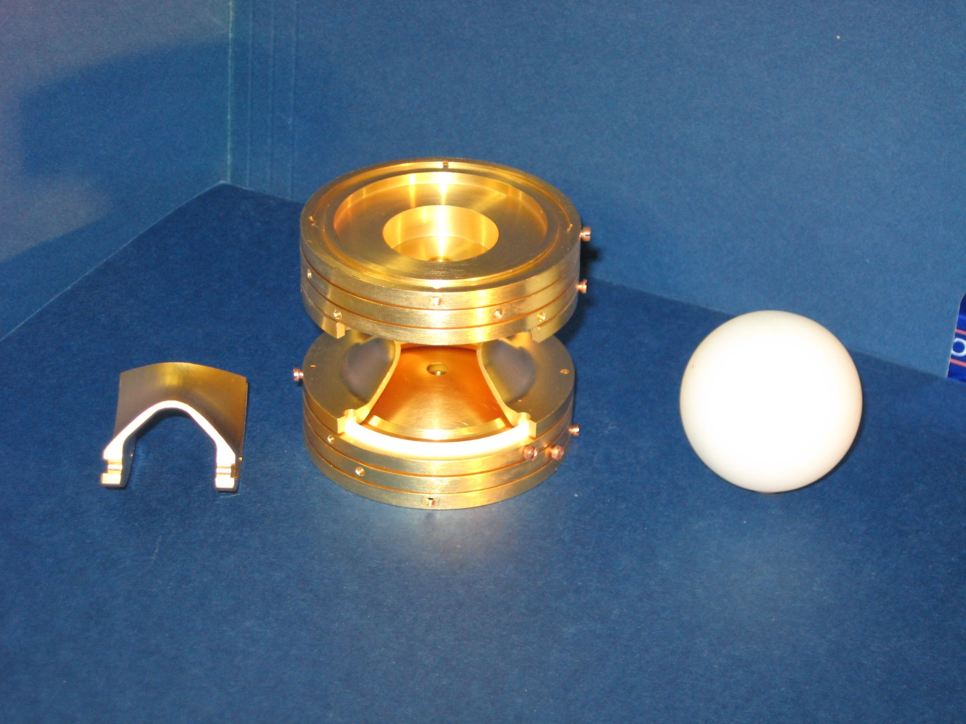
The Magic of the CPT
11/17/2010

Slide 12
How do we Measure Masses?
To make a precision measurement, it is best to take advantage of what can be measured most precisely: Frequencies
Put a charged particle in a magnetic field.
Measure the cyclotron frequency, ω_{c}
From Time-of-Flight, we know q
From a well known calibrant mass, we know B

Slide 13
Energy Conversion
Channeltron
TOF
Detection
Linear
Energy
Magnetic field lines outside the Penning trap
Orbital
Energy
Ions from the Penning trap

Slide 14
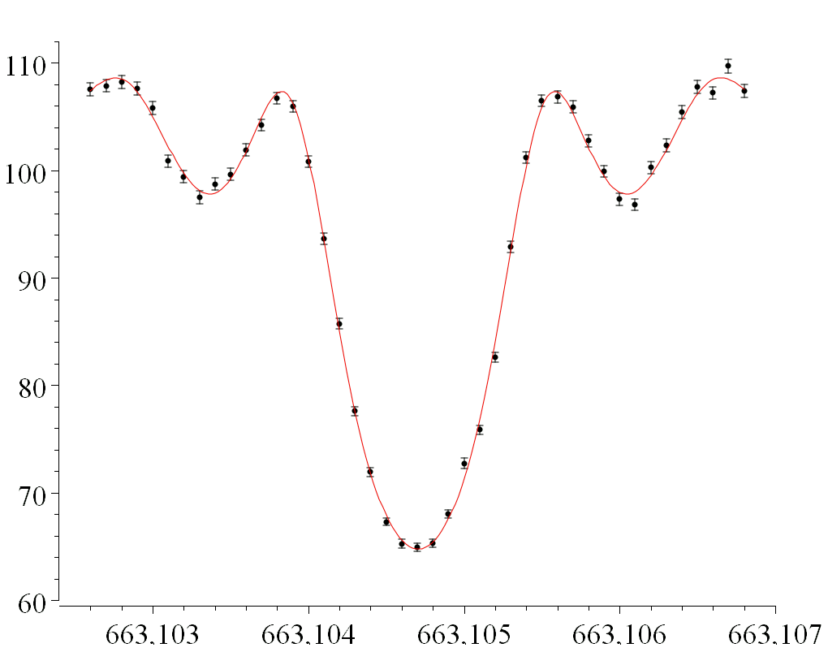
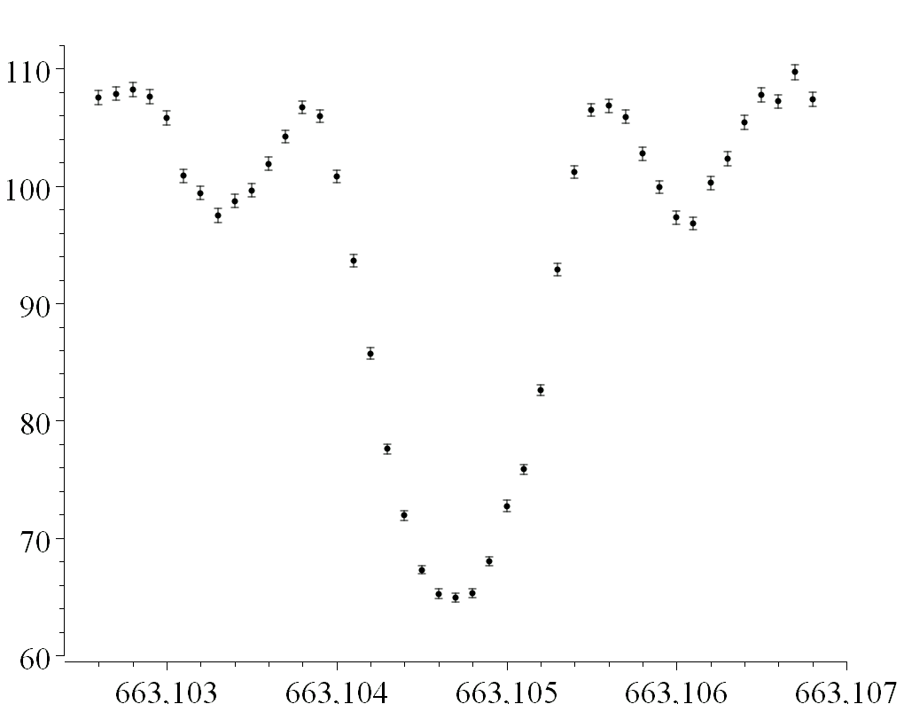
Sample time-of-flight (TOF) spectrum
Unknown:
Time of Flight (arb units)
f_{c}=663,104.706(3) Hz (560 eV/c²)
Well-known calibrant mass is a requirement for accurate measurements.
Slide courtesy of J. Van Schelt

Slide 15
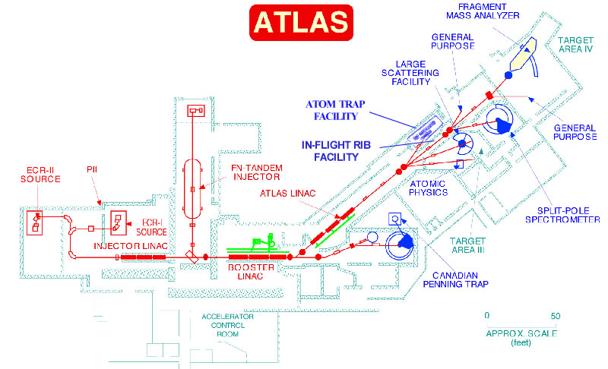
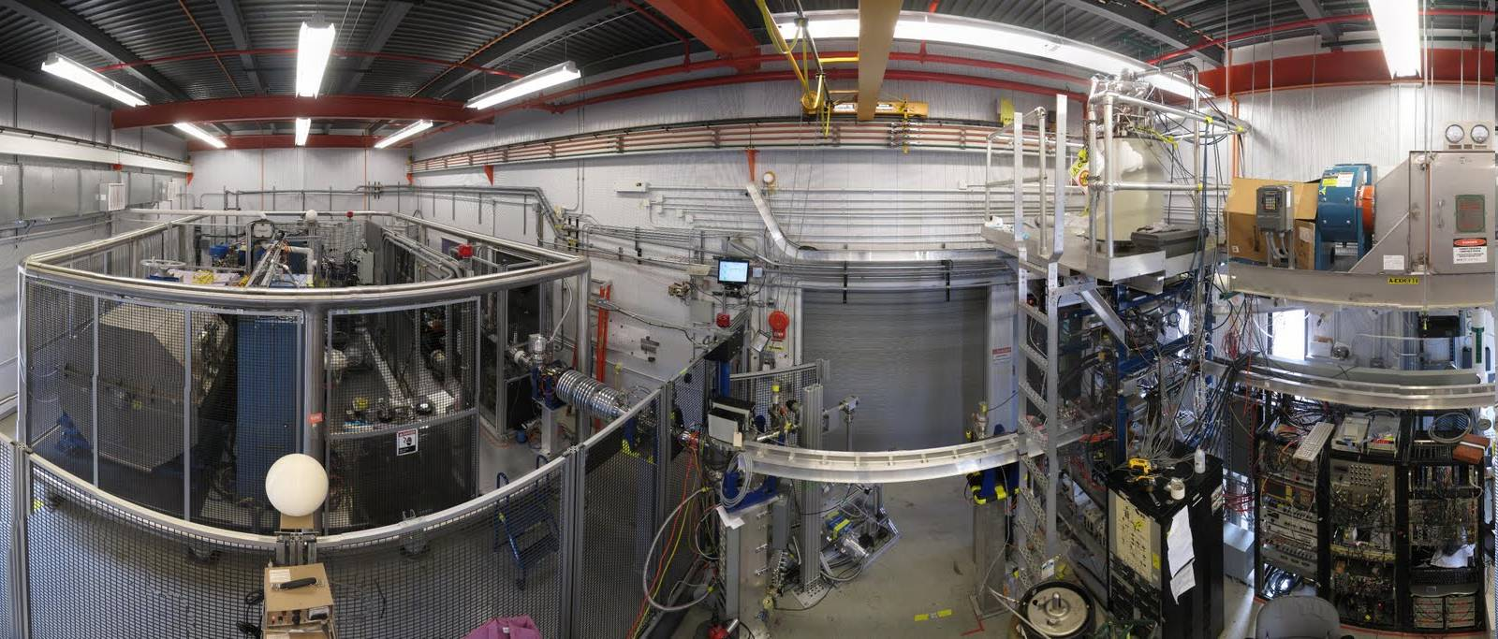
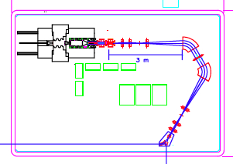
CARIBU (CAlifornium Rare Isotope Breeder Upgrade)
Photo courtesy of J Van Schelt

Slide 16
CARIBU: Big fission source in a big gas catcher
Main components of CARIBU
“ion source” is ²⁵²Cf source inside gas catcher / RFQ cooler
Thermalizes fission fragments
Extracts all species quickly
Forms low emittance beam
Isobar separator
Purifies beam
Best Resolution Achieved : ~1 part in 14,000
Low energy beamline
Leads to low energy area with space for 5 stopped beam experiments
Charge breeder
Increases charge state for post-acceleration
Post-accelerator
ATLAS with energy upgrade
Slide Courtesy of G Savard

Slide 17
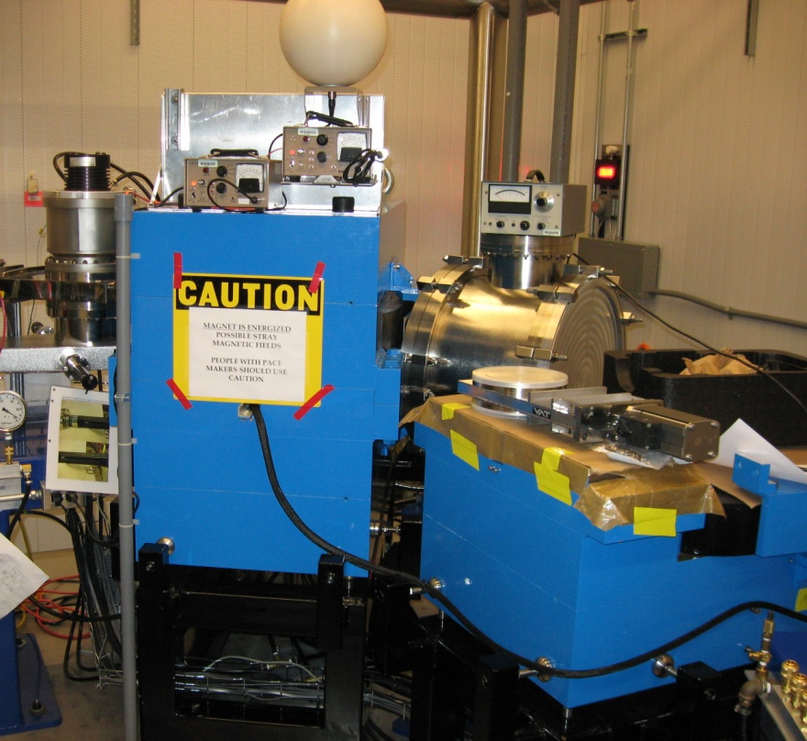
In-Flight Isobaric Separation
Beam Properties from the gas catcher:
ε ≈ 3π (mm · mradian)
δΕ ≈ 1 eV
1 mm diameter beam
θ_{max}, ϕ_{max}, = ± 6 mradians
Calculated Mass Resolution
1/20,000
Needed to separate weakly produced isobars
Resolution Achieved so far
1/10,000 to ECR source
1/9,000 to CPT
60º
Ribbon beam
Dispersion:
22.8 m
R = 50 cm

Slide 18
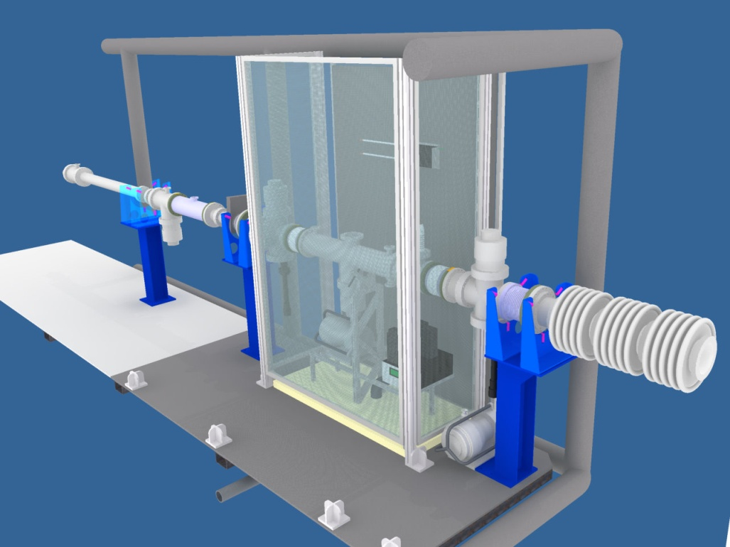
Radio Frequency Quadrupole (RFQ) Buncher
Photo courtesy of J Van Schelt

Slide 19
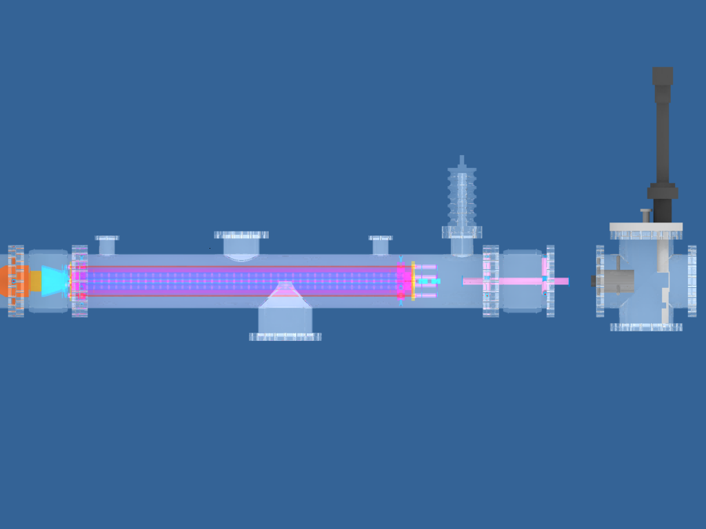
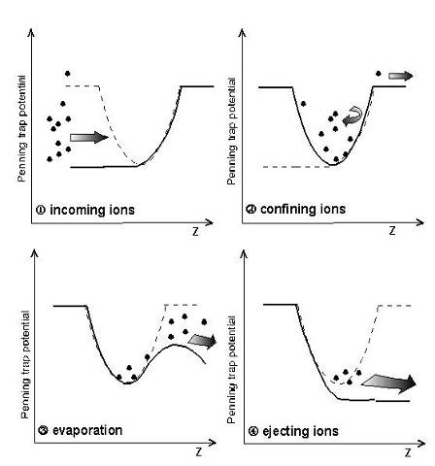
RFQ buncher+elevator provides cooled, pulsed beam to low energy area at requested energy.
Gas-filled RFQ
“Elevator”
Efficiency approaches 100%
Diagnostic station
50 kV isolation
Courtesy of J Van Schelt

Slide 20
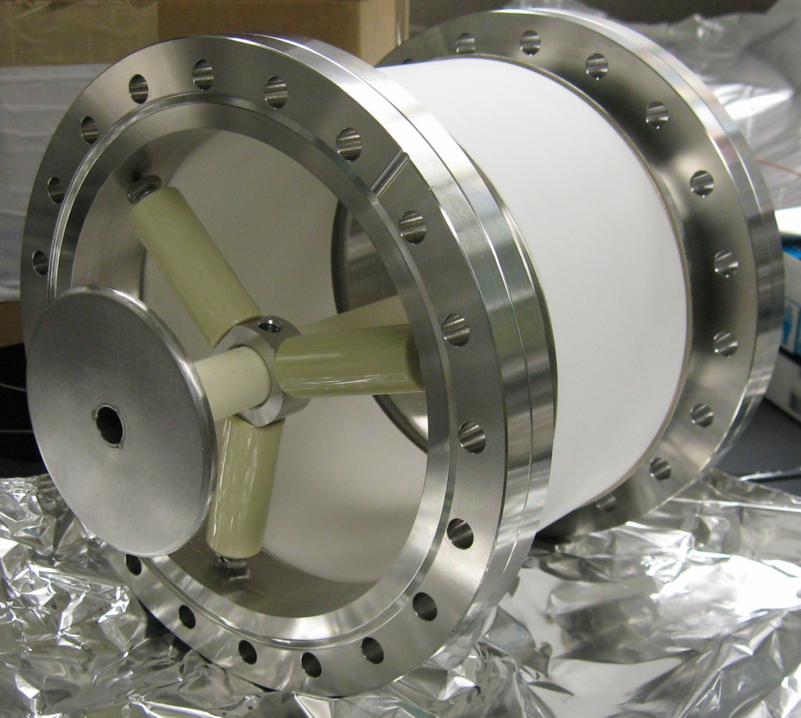
LEBL ELEVATOR
While bunched beam is inside tube, voltage is pulsed down from 50 kV ground.
While inside, the ions don’t see the field change so they aren’t reaccelerated to 50 keV
Experimenter controls ejection timing and beam energy
Notes:
Energy after the elevator is ~2.1 keV
We eject at 5 Hz
Upper limit on rate is ~10Hz

Slide 21
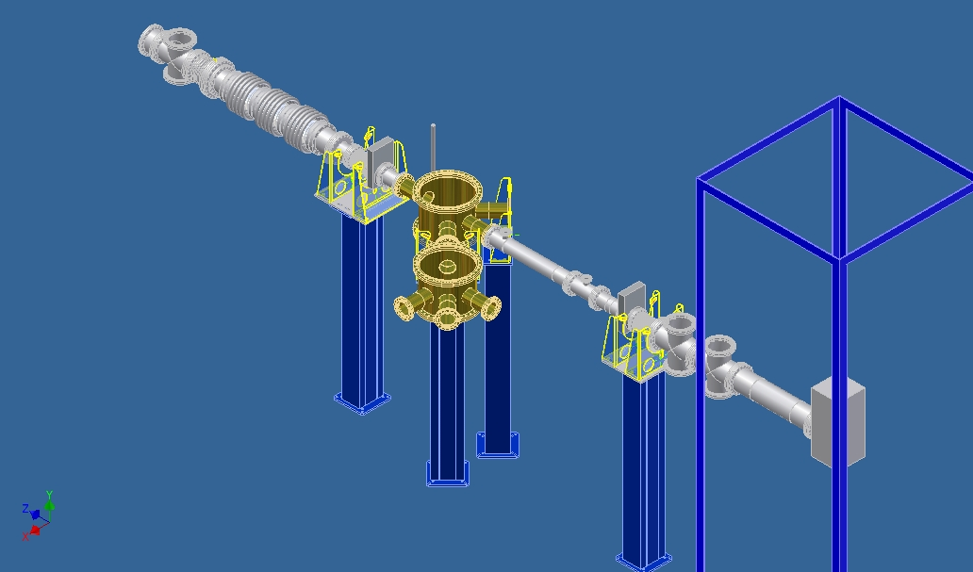
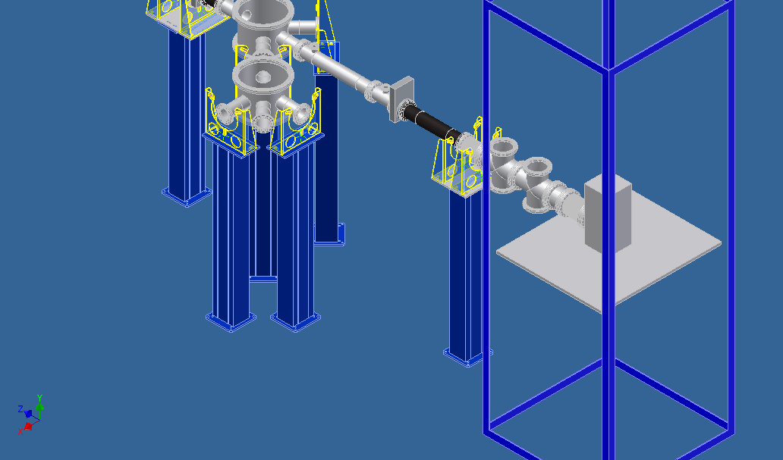
Mating CARIBU with the CPT
Notes:
Mating the CPT with CARIBU required the design of a new beamline that would accommodate multiple experiments
5 experiments (including the CPT) at a given time are possible.
But space is tight.

Slide 22

An Aside on CAD
It’s Free
All you need is a .edu email address
OR an invitation from someone with a .edu email address
It comes with tutorials.
If you need to build something, you need to be able to communicate your designs
http://students.autodesk.com

Slide 23
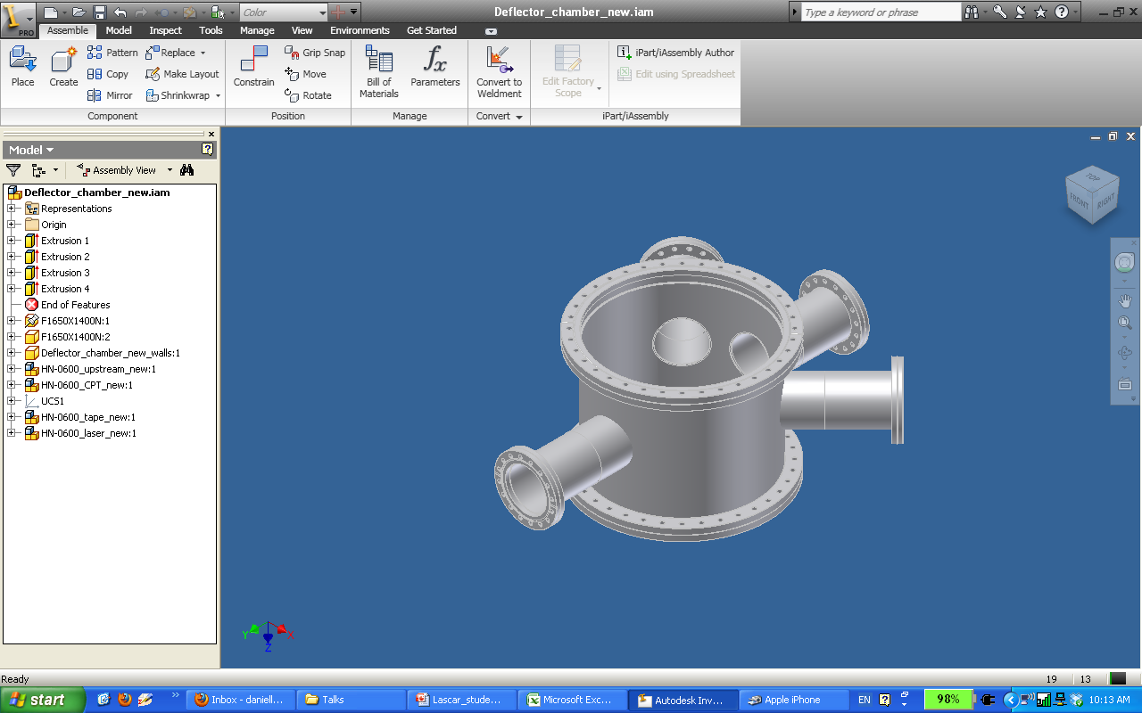
http://students.autodesk.com

Slide 24
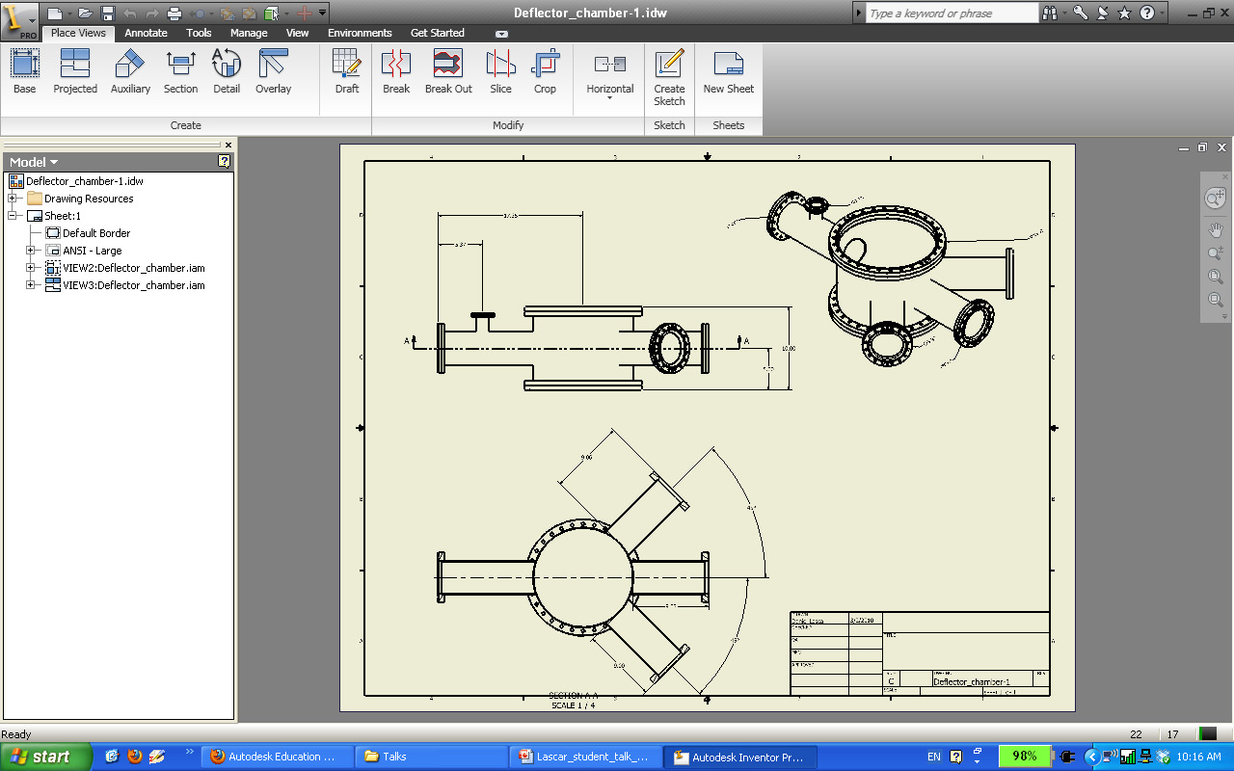
http://students.autodesk.com

Slide 25
Timeline of CPT’s CARIBU adventure
2009-07-28: (Rapidly) De-energize magnet in triangle room
2009-07-30: Riggers move CPT tower frame and magnet to CARIBU
2009-10-23: Re-energize magnet
2010: Clean Penning trap, reassemble transport system in CARIBU Design, Fabricate, Assemble Low-Energy Beam Line at CARIBU Commission CARIBU with test source Do ⁸Li runs and β-n runs with BPT in triangle room
2010-12-1: First cyclotron resonance (stable ¹³³Cs ions)
2011-03-21: First cyclotron resonance of radioactive CARIBU ions (¹⁴³Cs)
2011 Summer: Do first science runs near ¹³²Sn with commissioning beams
Used CPT as diagnostic to understand CARIBU and its limiting factors
Limited by CARIBU cleanliness and efficiency, LEBL stability
2011 Fall: CARIBU shutdown for upgrades
2012 January: PAC approves two CPT proposals for 60 days of CARIBU beam time (15 in combination with tape station (A.Y. Deo et al.))
2012 February: First Money run.

Slide 26
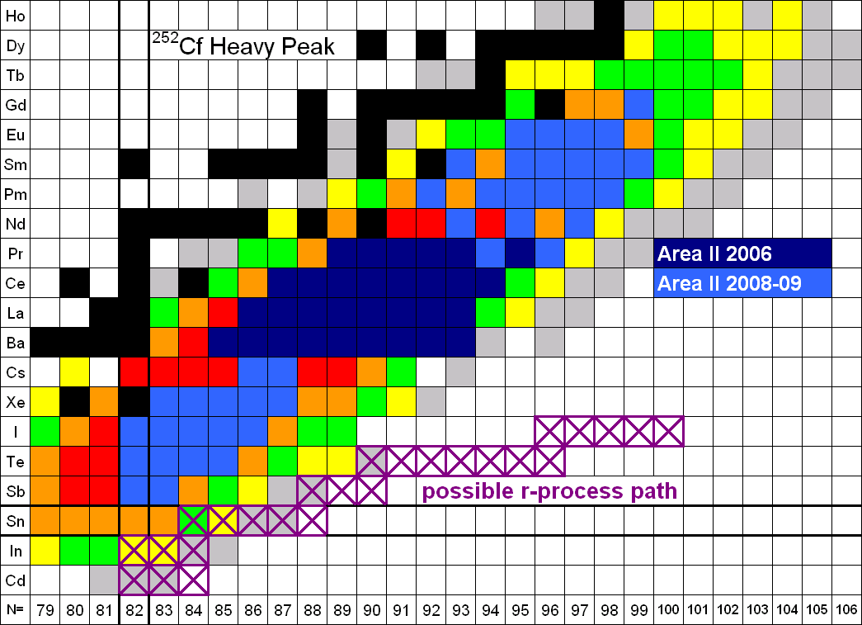
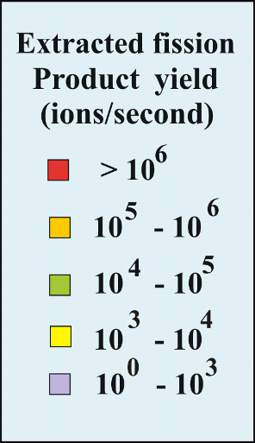
CPT Measurement campaigns

Slide 27
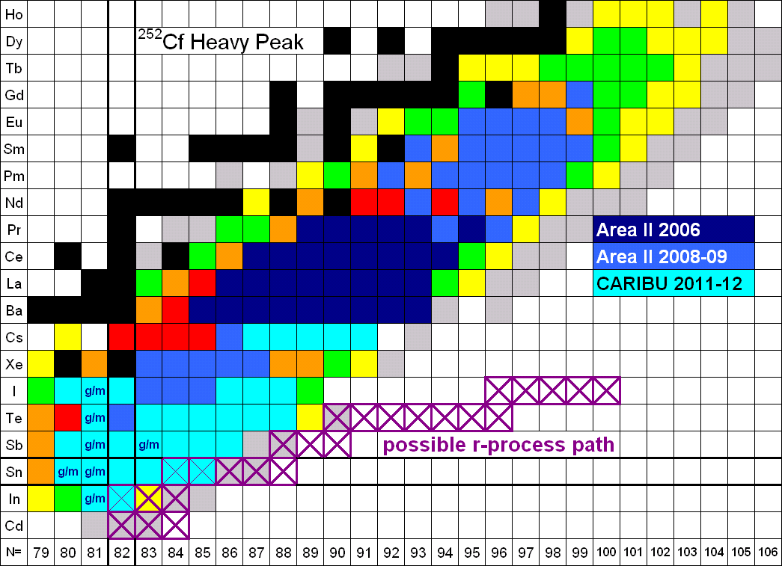
CPT Measurement campaigns
New to Penning traps

Slide 28
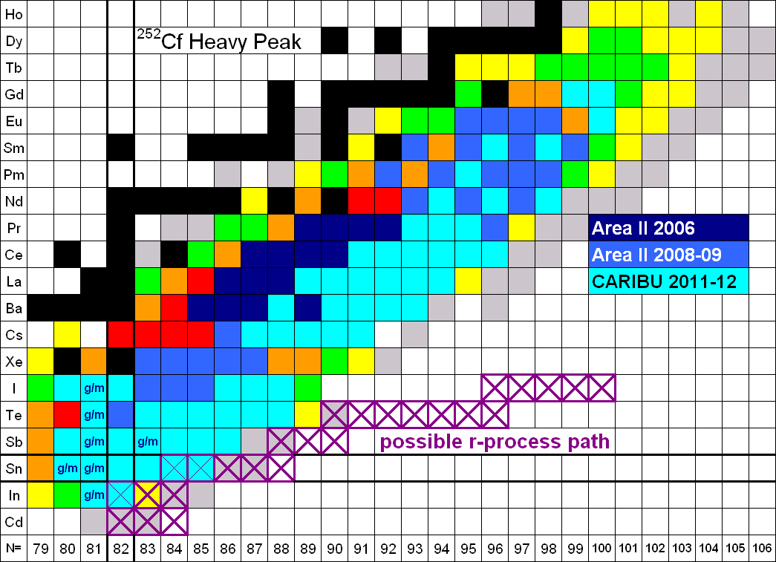
CPT Measurement campaigns

Slide 29
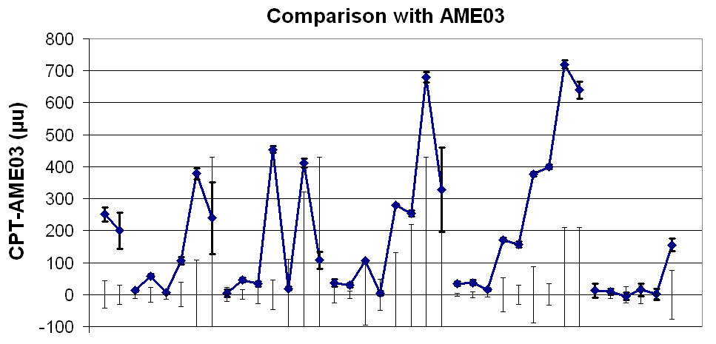
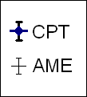
AME03 comparison
¹³⁰In
¹³⁰⁻¹³⁵Sn ¹³¹⁻¹³⁷Sb ¹³³⁻¹⁴⁰Te ¹³³⁻¹⁴¹I ¹⁴¹⁻¹⁴⁶Cs
¹³¹In

Slide 30
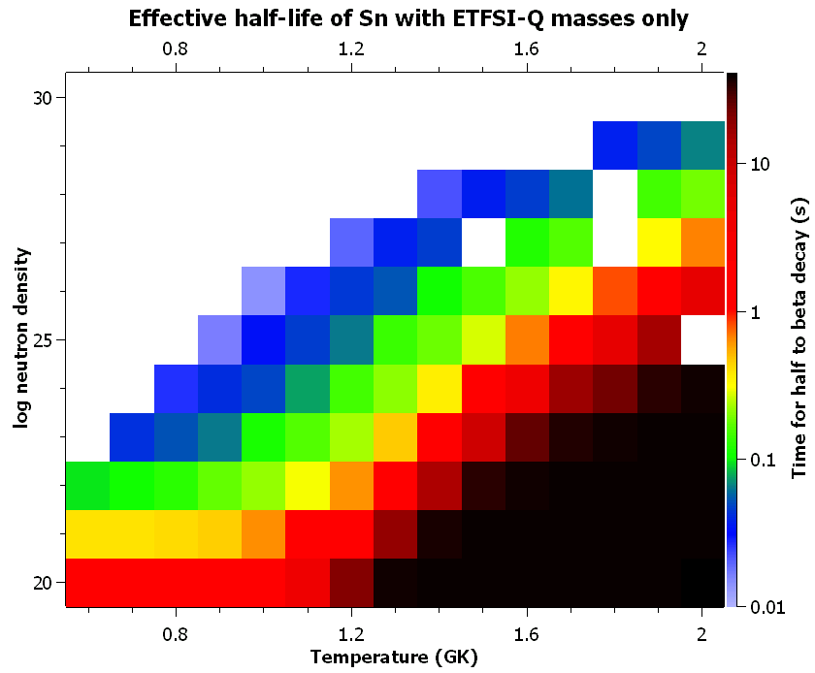
No Data (A > 150)
(cm⁻³)

Slide 31
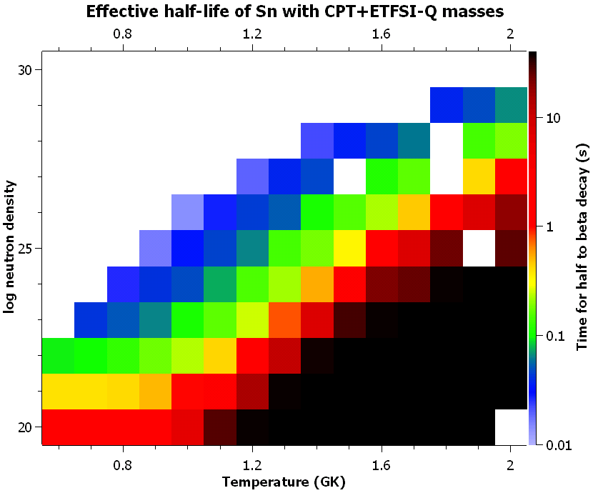
No Data (A > 150)
(cm⁻³)

Slide 32
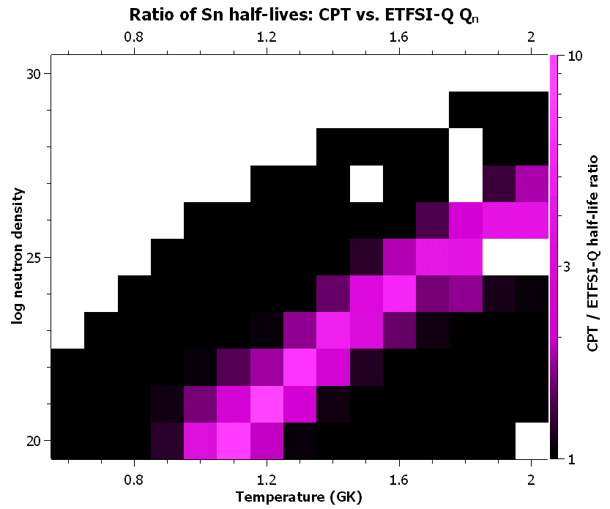
No Data (A > 150)
(cm⁻³)

Slide 33
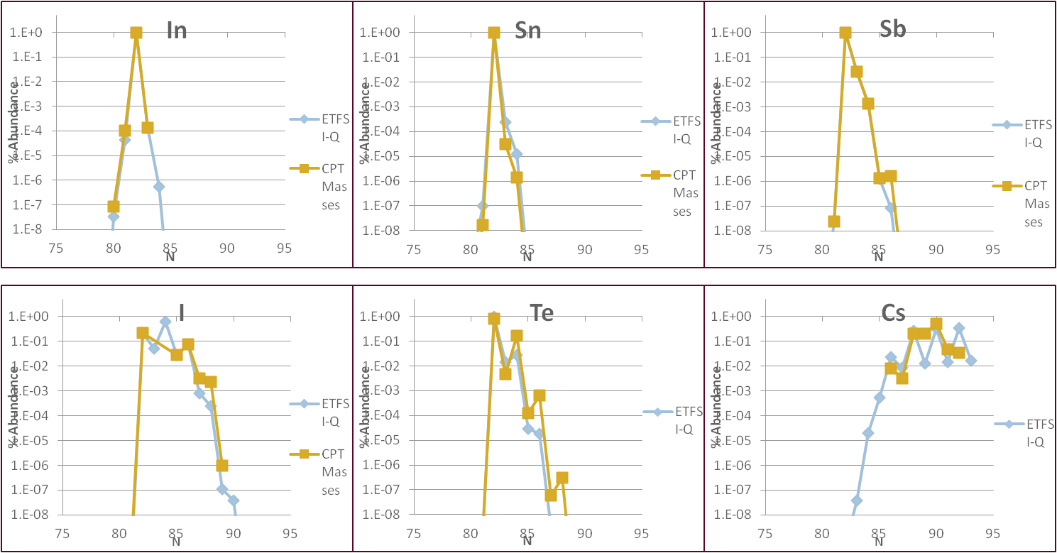
Saha Analysis – A bit more global T₉ = 2 GK, n_{n} = 10²⁴ cm⁻³

Slide 34
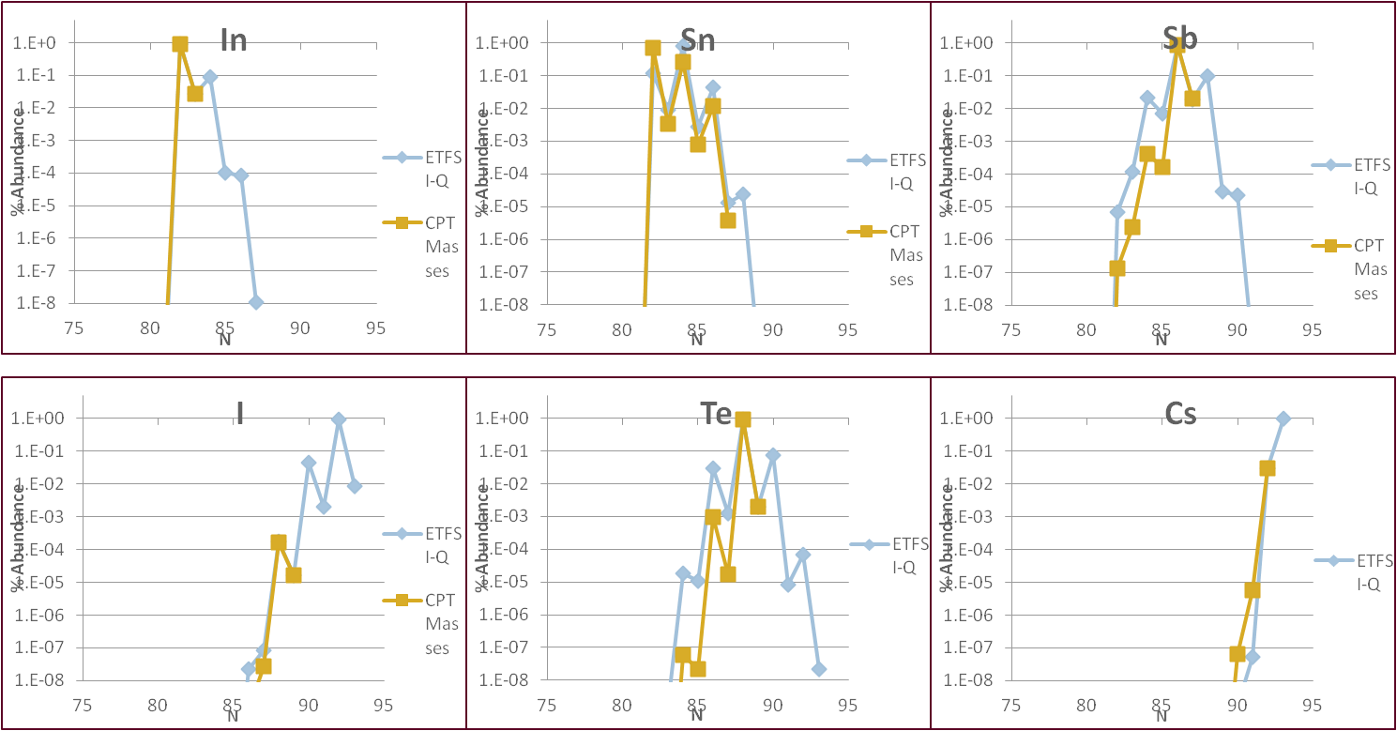
Saha Analysis – A bit more global T₉ = 1.5 GK, n_{n} = 10²⁴ cm⁻³

Slide 35
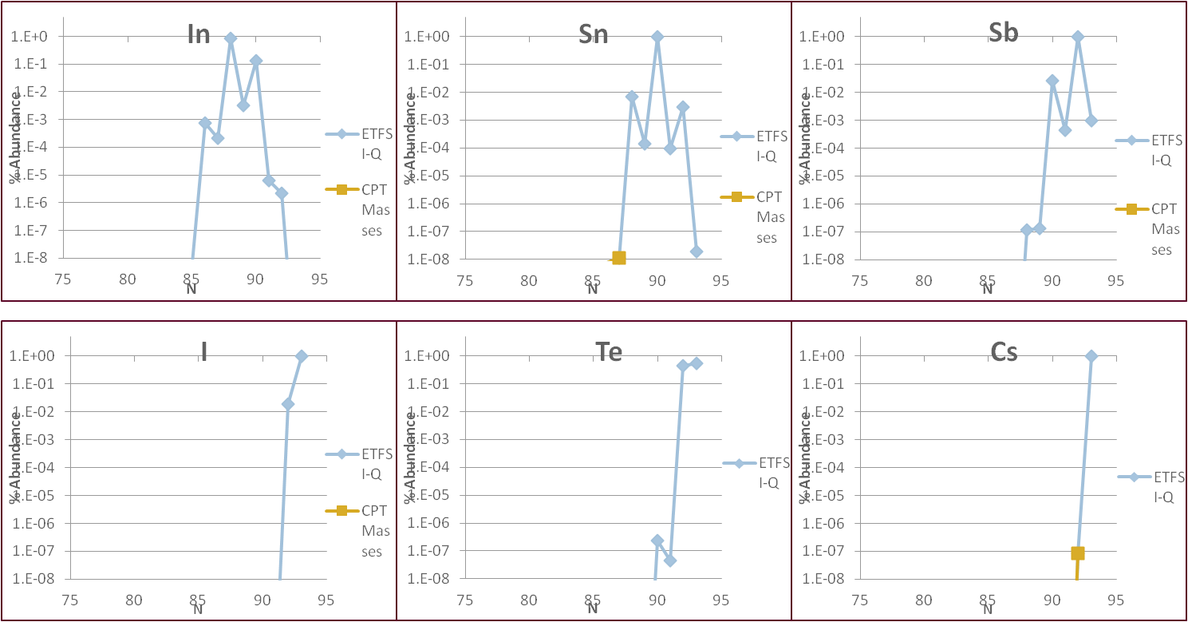
Saha Analysis – A bit more global T₉ = 1.0 GK, n_{n} = 10²⁴ cm⁻³

Slide 36
Conclusion
CARIBU is up and running. CARIBU was up and running and will be again.
We have measured many masses on the r-process path and will continue to do so.
We can also look at the N=50 closed shell and do a similar analysis.
Jon and I are graduating soon (really, I mean it this time) and we need new grad students.
Join now and be among the first to use new CARIBU!

Slide 37








CPT Collaboration
G. Savard, P. Bertone, J.A. Clark, C. Deibel, A.P. Galvan, J.P. Greene, A.F. Levand, B.J. Zabransky
Argonne National Laboratory
S. Caldwell, M. Sternberg, J. Van Schelt
D. Lascar, R. Segel
K.S. Sharma
C. Deibel
N.D. Scielzo, R. Yee
F. Buchinger, J.E. Crawford, S. Gulick, Gang Li
Gang Li
Notes:
Thank Jason, Jon, Ralph, Guy, and Adrian for their help

